Slide 1
Your logo here
is proud to offer you

Slide 2
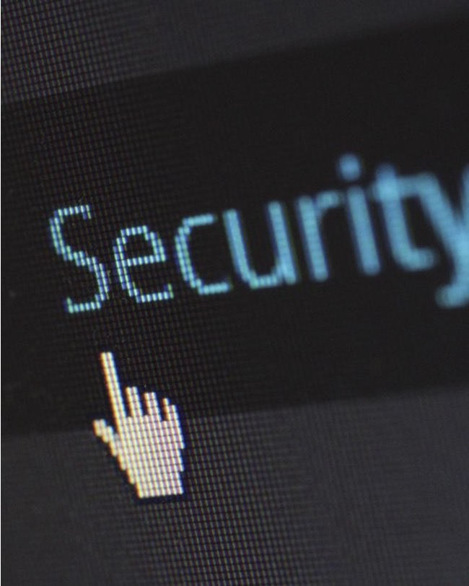
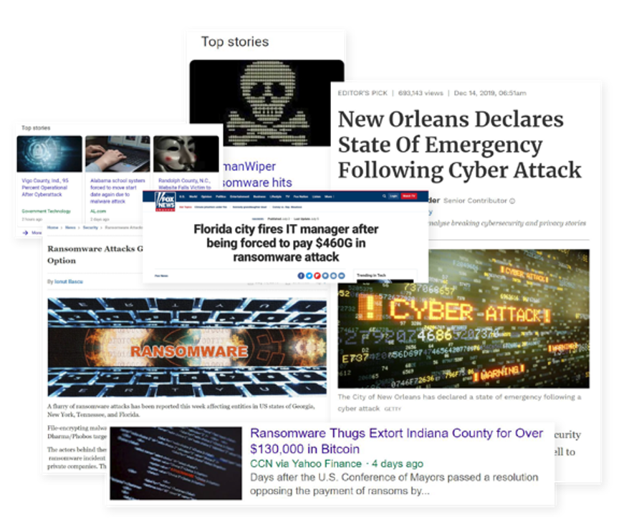
Every 14 Seconds
$338,700
average ransom paid
77% of companies infected with ransomware were running up-to-date endpoint protection. (source: Sophos)
We can stop it, but we have to be proactive. CryptoStopper™ is our last line of defense against ransomware
Notes:
54% of US organizations reported being hit by ransomware in 2019. Now the attackers are not only locking up your data, but stealing it and holding it for ransom.

Slide 3
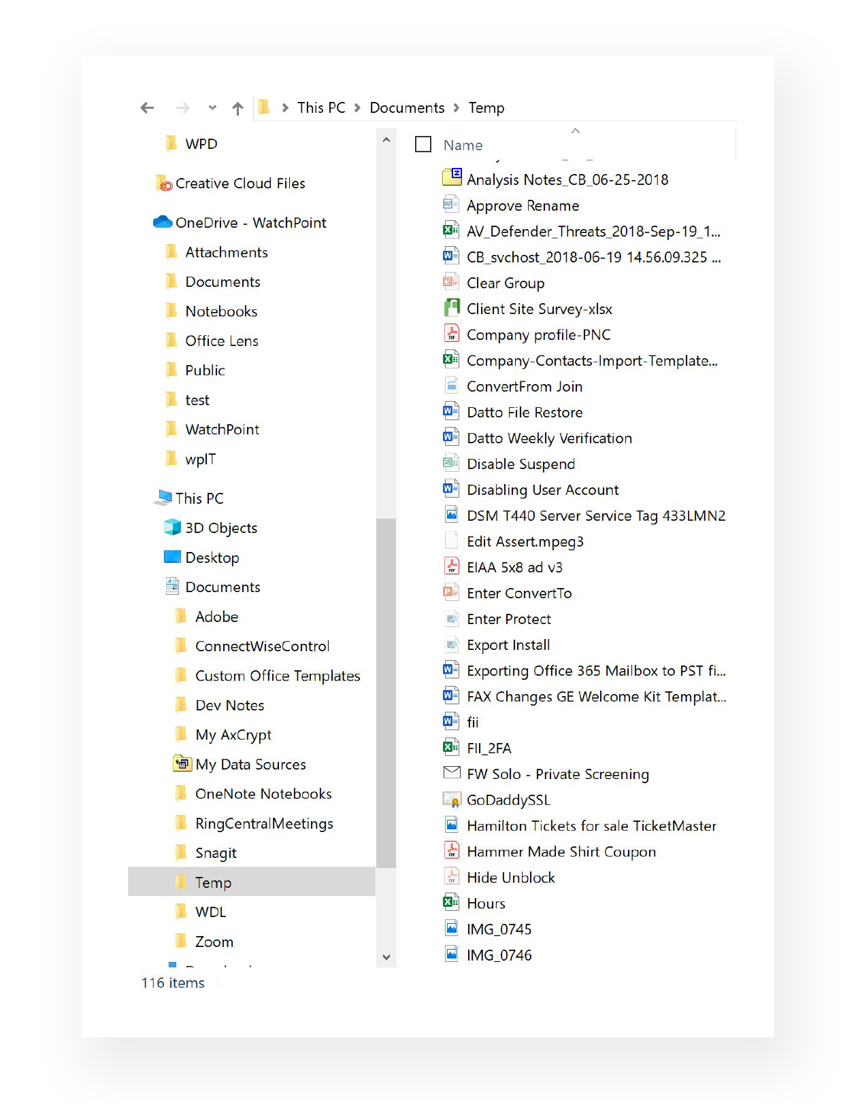
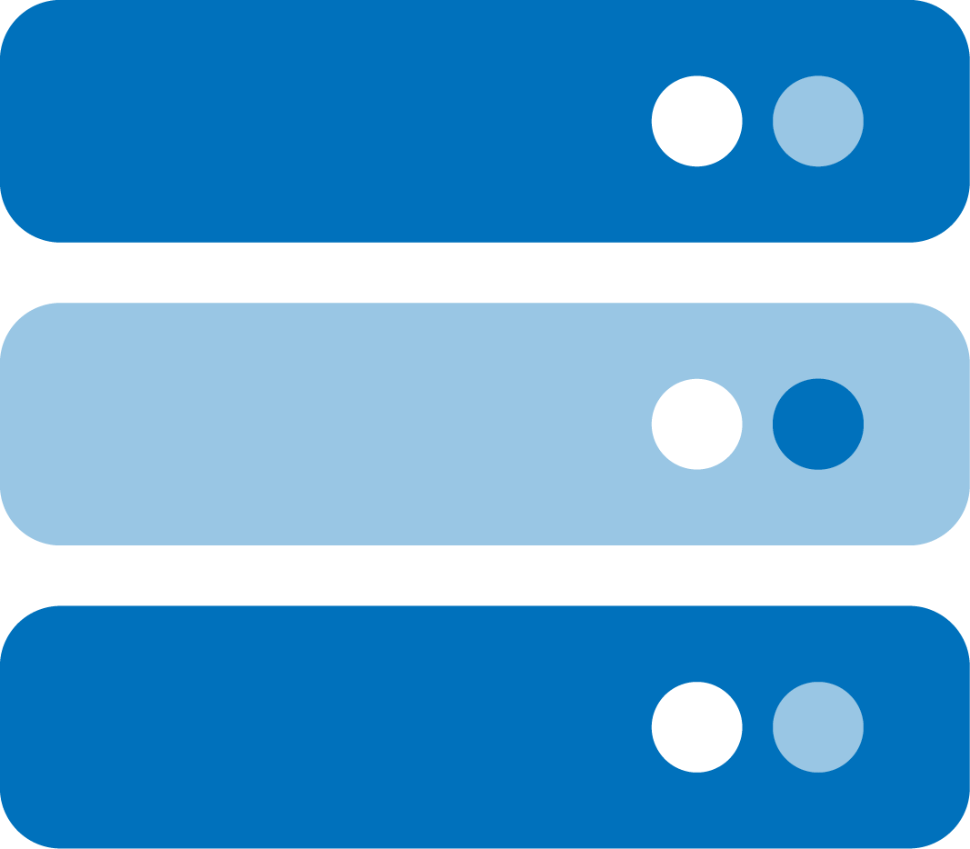
How it works
Workstation
Share
File Server
Ransomware monitoring on network (all endpoints)
Ransomware (encryption) detected
Endpoint isolated automatically
Administrator is notified via Email
Different approach than AntiVirus
Stops ransomware in milliseconds
Actively isolates device from the network to keep it from spreading
Notes:
I want to make sure you are as protected as possible and there is a new product called CryptoStopper that uses bait files to detect and stop ransomware. We currently have…(current security stack – AV, patch management, backup, etc.), but feel CryptoStopper is the only way to protect against ransomware.

Slide 4
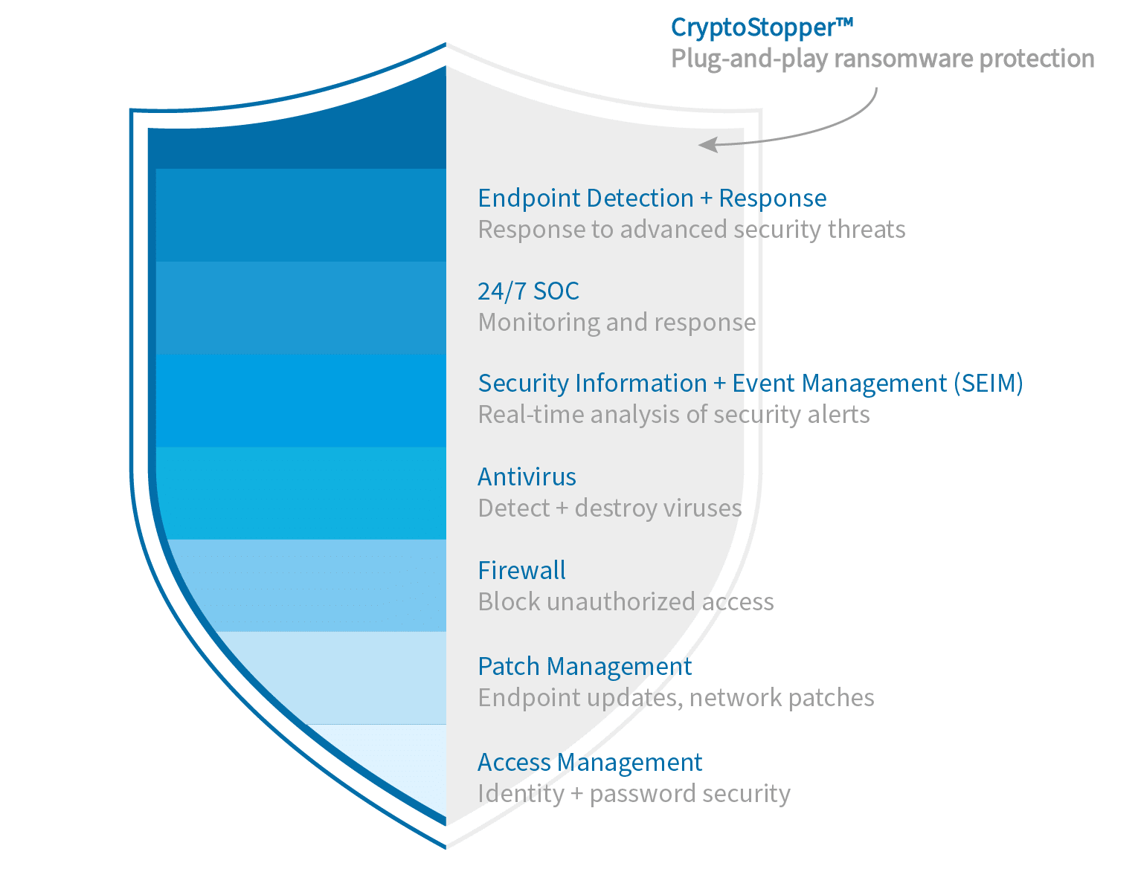
Added Layer of Security
Different approach than Antivirus
Stops ransomware in milliseconds
Actively isolates device from the network to keep it from spreading

Slide 5
Your last line of defense.

